Slide 1
Forensics – 2017/18
Case 1052-12467

Slide 2
6:02 Tuesday, September 12, 2017
E. Locard was on routine night patrol at OEHS on 9/11/17
Walking through E-wing, 2nd floor at 10:23pm
Heard loud banging noises from G-wing
Searched 2nd floor first, then up to 3rd after hearing loud pounding
Came up Southeast stairwell and saw door to G343 classroom open
Saw scene in back lab area and taped off section
Called for backup at 10:35pm

Slide 3
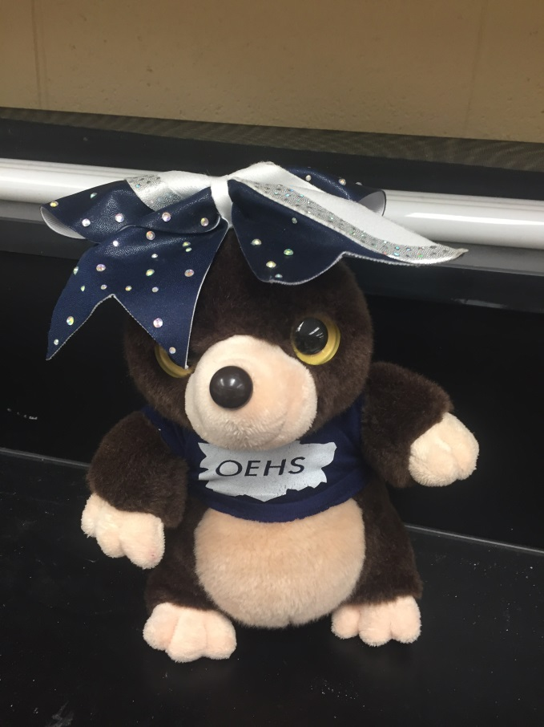
Room G343
Additional Investigation
Pet mole – Pica missing
Video surveillance was cut to G & F wings
Called Ms. Scholle & Mr. Korczak to view scene and ID any missing items/persons
All Science teachers are suspects

Slide 4
Your Job:
Fully process scene – you will have today and tomorrow
Maximum 10 investigators at a time in the scene
Take measurements and notes for initial and final sketches
Take photos of scene and evidence (if evidence is not pictured you will not get it!)
Use “handbook” to guide your process
Record a video walkthrough of scene for future reference
Compile evidence into one sheet (link)
Begin completing Chain of custody forms (link)

